Slide 1

AL Salam hospital by john khalil johnkhalil384@gamil.com https://github.com/johnkhalil25 https://www.linkedin.com/in/john2001-dataanalysis/

Slide 2
Introduction
An analytical report was prepared for Al-Salam Hospital using Tableau, where the necessary metrics were developed to conduct a comprehensive analysis and achieve accurate and satisfactory results. The work included the creation of two dashboards to display the analyses interactively.
The report covered the analysis of patients’ age groups, the number of doctors in each department, and their work shifts, in addition to discussing the most common diseases based on each age group. A chart was also created to show the distribution of patients by blood type.
Furthermore, the report analyzed the total revenue and the number of visits in each department, as well as the average years of experience of doctors. The aim was to provide a comprehensive view that supports decision-making and enhances the quality of medical services at the hospital.

Slide 3
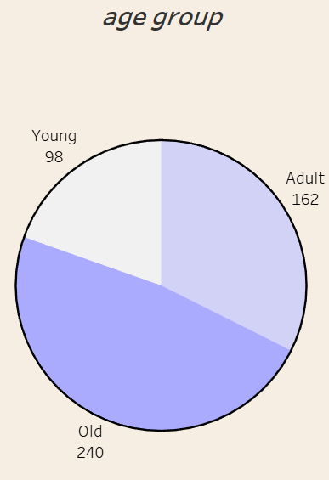
"The first feature shows that the number of elderly patients is the highest, followed by adults and then children. This is logical, as aging increases the likelihood of developing diseases."

Slide 4
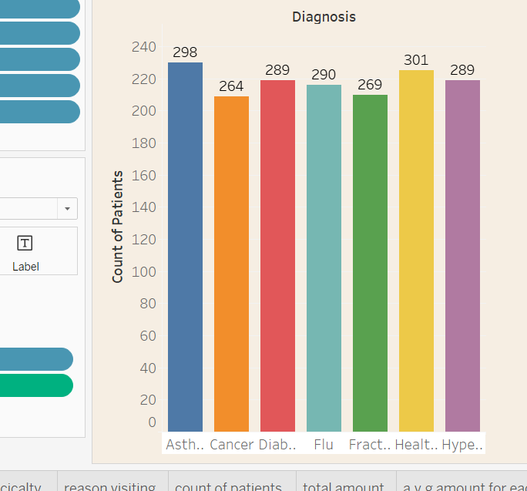
The highest number of patients was recorded under general health issues, followed by asthma, while cancer had the lowest.
Chronic diseases such as asthma, hypertension, and diabetes showed relatively high patient counts, which is expected due to their long-term prevalence.
The variation between diseases is not very large, indicating that the hospital handles a wide range of conditions with close patient numbers.

Slide 5
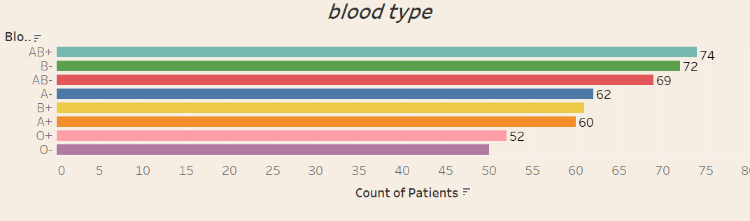
There is a close distribution of patients across most blood types, with a noticeable prevalence of AB+ and B-.
The O blood group (O+ and O-) recorded the lowest patient counts.
Overall, the distribution is relatively balanced, indicating that the hospital receives patients from all blood groups without major differences.

Slide 6
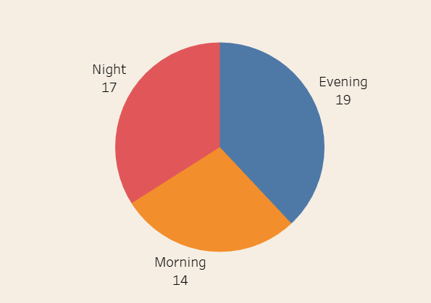
Although the chart shows that the number of doctors in the morning shift is low, this period actually records the highest number of visits, which may indicate pressure on the medical staff compared to the available doctors.

Slide 7
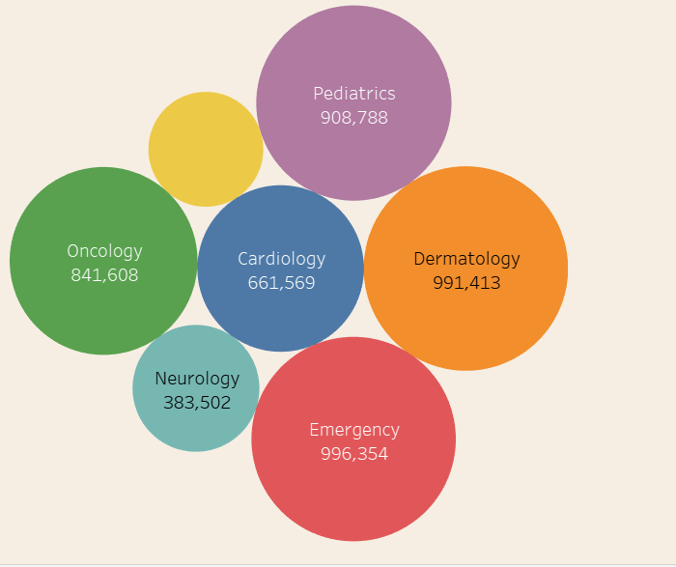
The highest income comes from the emergency and dermatology departments due to high demand and fast services.
Pediatrics and oncology generate a moderate level of income.
Cardiology and neurology record the lowest income despite their importance, which may be linked to pricing models or the nature of cases. 📌 Overall: Income is influenced by the number of patients, service cost, and patient turnover speed, not only by the medical specialty’s importance.

Slide 8
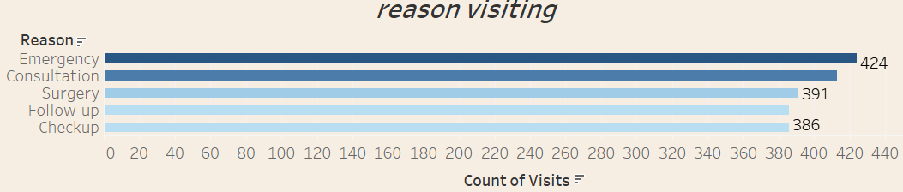
Emergency is the most common reason for visits, followed by consultations and then surgeries.
Check-ups and follow-ups are nearly equal, reflecting good health awareness. 📌 Conclusion: There is a balance between urgent and preventive care, but the high number of emergency visits may indicate gaps in primary care or delayed diagnosis.

Slide 9
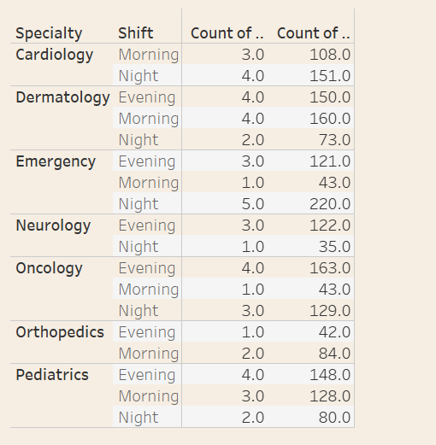
The emergency department is the most overloaded, especially at night, and requires additional staffing.
Oncology and neurology are more active in the morning and evening, reflecting the nature of scheduled treatments.
Pediatrics and dermatology see higher demand in the evening due to social factors.
Cardiology and orthopedics show a gradual or balanced distribution of cases. 📌 Conclusion: There is a mismatch between staff distribution and case load, which calls for reorganizing human resources to achieve better efficiency.

Slide 10
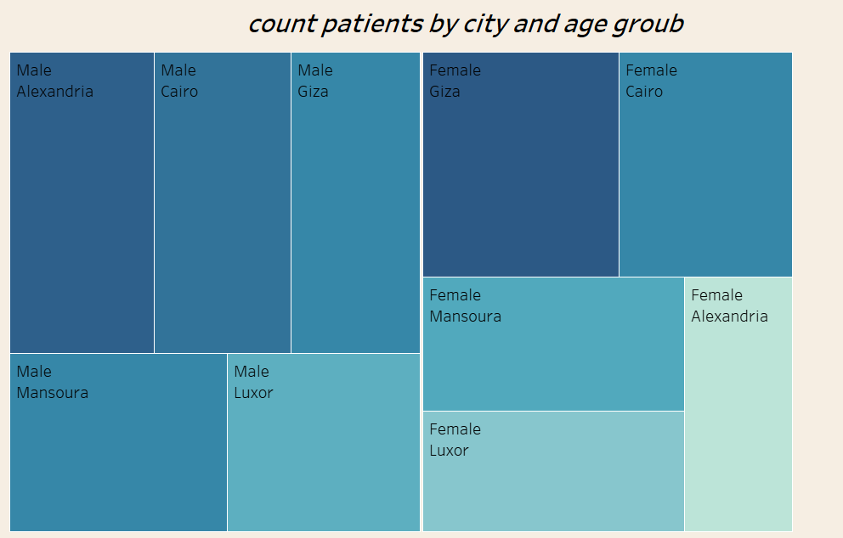
Giza ranks first in patient numbers, especially among males, which may be linked to population density, concentration of health services, or common disease patterns.
Cairo comes next, with a similar trend of higher male representation.
Smaller cities like Luxor and Mansoura show lower representation, possibly due to smaller populations or limited access to healthcare services.
Alexandria shows relatively limited representation, particularly among females. 📌 Conclusion: The distribution indicates that patient density is influenced not only by population size but also by factors such as availability of healthcare services, health awareness, and gender differences in seeking medical care.

Slide 11
Avg.amount | 2,549$
Total amount | 5,097,982$
patients | 500
doctors | 50
visits | 2000
Avg.experience | 20.90 year

Slide 12
📌 Final Conclusions
Elderly patients represent the most vulnerable group, requiring specialized healthcare services.
Chronic diseases (such as hypertension and diabetes) and emergency cases are the most common, highlighting the need to strengthen preventive programs and primary care.
There is a misalignment in doctor distribution, especially in the morning shift, where staff numbers do not match the high patient volume.
Departmental income is influenced not only by the medical importance of the specialty but also by patient volume, service cost, and speed of care.
The emergency department requires additional support at night due to high patient load.
Evening shifts show increased demand in dermatology and pediatrics, likely linked to work and family schedules.
Geographical distribution shows that Giza and Cairo account for the largest share of patients, which may relate to population density and service availability.
There is good health awareness, reflected in regular check-ups and follow-ups, but the high emergency visits suggest gaps in preventive care and early diagnosis.

Slide 13
📌 Recommendations
Improve medical staff distribution:
Increase the number of doctors in the morning shift, as it has the highest patient volume.
Support the emergency department during the night shift with more doctors and nurses to reduce overload.
Enhance preventive care:
Invest more in regular check-up programs and early diagnosis to reduce pressure on the emergency department.
Launch health awareness campaigns targeting chronic diseases (hypertension, diabetes, asthma), especially for the elderly.
Restructure medical service pricing:
Review the pricing of cardiology and neurology services, as they generate low income despite their medical importance and disease prevalence.
Improve revenue strategies by expanding high-demand and quick services such as dermatology and emergency.
Improve patient experience:
Extend the working hours of certain clinics (e.g., dermatology and pediatrics) in the evening to meet rising demand.
Reduce waiting times through better appointment management.
Human resource management:
Align staff numbers with patient volumes in each department using regular monitoring and analysis systems.
Provide additional training for medical teams in high-pressure departments (e.g., emergency).
Geographical service distribution:
Consider opening branches or satellite clinics in underrepresented cities (e.g., Luxor, Mansoura) to expand healthcare access.
Focus on Giza and Cairo, which have the highest patient density, by strengthening medical infrastructure.

Slide 14
AL Salam hospital john khalil johnkhalil384@gamil.com https://github.com/johnkhalil25 https://www.linkedin.com/in/john2001-dataanalysis/ thank you

